Slide 1
FUNDAMENTALS OF MANAGEMENT
What do Beaunit Mills, Hercules Powder,
And Liebmann Breweries have in common?
On 1st Fortune List (1955)
They Don’t Exist Today
“BAD Management”
Not “Keeping up the Good Work”
Not adapting to Environmental Changes

Slide 2
Management Defined
Dictionary defines ,management as:
A collective noun to refer people, group of people engaged in managing an organization.
The word is also used to refer to a particular activity such as controlling the people.
Management is a set of activities including planning and decision making organizing leading and controlling directed at an organizations resources, human, financial, physical and information with the aim of achieving organizational goals in an efficient and effective manner.

Slide 3
Definition contd….
F.W. Taylor (Fredrick Winslow Taylor):
Management is knowing exactly what you want men (people) to do and then seeing that they do it in the best and cheapest way.
Peter Drucker:
Defines management from a resource based perspective:
Effective and efficient use of available resources to achieve desired results.

Slide 4
CONTINUE….D
According to Mary Parker Follett:
Management is the “art of getting things done through people”.
Definition
It is the process of designing and maintaining
an environment in which individuals, working, together in groups efficiently accomplish selected aims.

Slide 5
DEFINITION Continued
George R Terry :- defines management as a process
consisting of planning organizing actuating and
controlling, performed to determine and
accomplish the objectives by the use of people
and resources.
Management:
Applies to any kind of organization.
Applies to managers at all organizational levels
Managers carry out the functions of planning
Is concerned with productivity; implies effectiveness and efficiency

Slide 6
Peter Drucker’s Philosophy of Management
A society consists of several organizations such as universities, churches, cultural organizations, public service institutions and business enterprises.
All these are organs of society.
They exist to fulfill a specific purpose and satisfy a need of society, community or individual of all the organs, business enterprise alone is primarily charged with the task of economic development.
Drucker therefore calls it the specific economic organ of society.

Slide 7
Drucker’s Philosophy continued
There are three tasks the management has to perform to enable the institution to function and contribute:
Fulfilling the specific purpose and mission of the institution.
Making work productive and worker achieving.
Managing social impacts and social responsibility.

Slide 8
CHARACTERISTICS of management
Is a universal activity
Is a dynamic process
Is goal oriented
It is a group activity
Is a science as well as an art
Management is a system of authority
Management involves decision making
Draws ideas and concepts from various disciplines

Slide 9
characteristics continued
Managers are responsible for combining and coordinating these various resources to achieve the organizations goals
As managers, people carry out the managerial functions of planning organizing, staffing leading and controlling
Management applies to any kind of organization
It applies to managers at all organization levels
The aim of all managers is the same to create a surplus
Managing is concerned with productivity, this implies effectiveness and efficiency.

Slide 10
The management process
It is the process of setting goals and objectives and accomplishing them in an efficient and effective manner through the co- ordinated use of human, financial, physical and information resources within the context of the dynamic environment.
This process involves several core functions including planning organizing directing and controlling.
Efficiency: The ability to use resources wisely and in a cost- effective way i.e. the ability to minimize the use of time, money and other resources in achieving organizational objectives doing things right.
Effectiveness: The ability to make right decisions in determining the appropriate objectives and accomplishing them successfully doing the right things.

Slide 11
Role and importance of management
No enterprise can survive without management, even if it possesses huge money, excellent machinery and expert man power, because it will be all confusion and no body will know what to do and when to do.
It guides and controls the activities of man power for the optimum utilization of company resources such has men, materials, money machines methods
It creates a vital, dynamic and life giving force to the enterprise.
Coordinates activities of different departments in an enterprise and establishes team- spirit among the persons.

Slide 12
Importance continue…d
Provides new ideas and vision to the organization to do better
Takes business problems and provides a tool for the best way of doing things.
Can meet the challenge of change.
Provides stability to the enterprise by changing and modifying the resources in accordance with the changing environment of the society

Slide 13
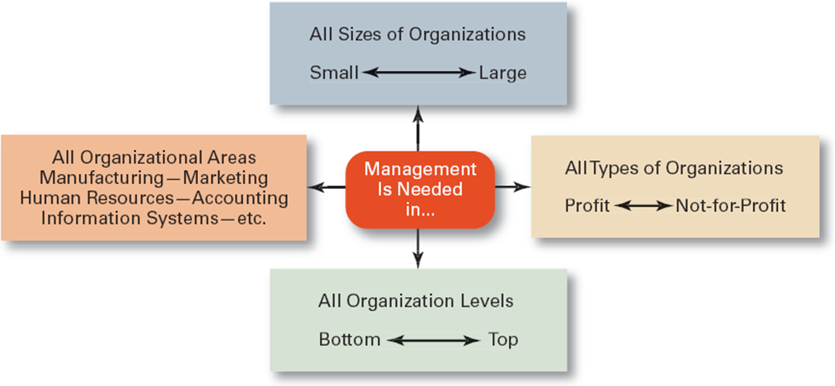
Universal Need for Management

Slide 14
features of a good industrial management
Management is purposeful: deal with the achievement of some thing specific expressed as an objective or goal.
Management makes things happen: Managers focus their attention and efforts on bringing about successful action.
Management is an activity not a person or group of persons: People who perform management can be distinguished designated as managers, members of management or executive leaders

Slide 15
Features continued
4. Management is usually associated with the efforts of a group is also applicable to an individuals efforts.
5.Management is intangible its presence evidenced by the results of its efforts.
6.Management principles and techniques are universally applicable to all group activities performed at any level of organization.
7. Management is aided not replaced by the computer: computer is an extremely powerful tool of management. It can widen a manager’s vision and sharpen insight by supplying more and faster information for making key decisions.

Slide 16
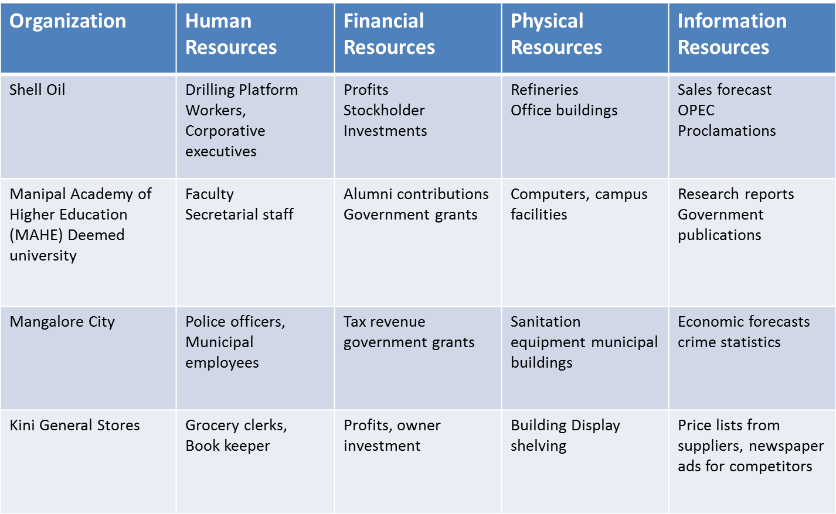
Examples of Resources Used by Organizations

Slide 17
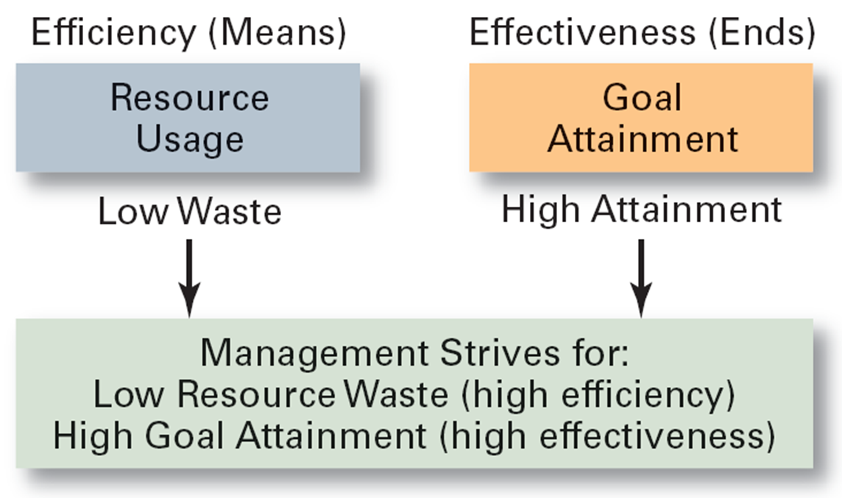
Efficiency and effectiveness in management

Slide 18
ORGANIZATION
A systematic arrangement of people brought together to accomplish some specific purpose; applies to all organizations—for-profit as well as not-for-profit organizations.
Common characteristics
Goals
Structure
People

Slide 19
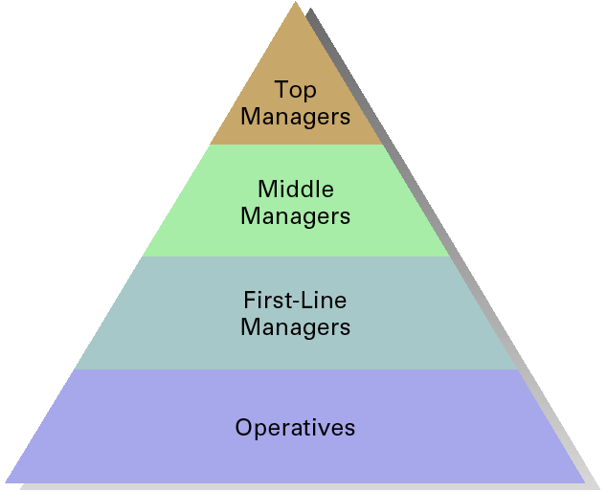
Organizational Levels

Slide 20
Identifying Managers
1. First-line managers
Supervisors responsible for directing the day-to-day activities of operative employees who perform many of the specific activities necessary to produce goods and services 2. Middle managers
Individuals at levels of management between the first-line manager and top management
Responsible for finding the best way to organize human and other resources to achieve organizational goals

Slide 21
continued
3. Top managers
Individuals who are responsible for making decisions about the direction of the organization and establishing policies that affect all members
Responsible for the performance of all departments and have cross-departmental responsibility.
Establish organizational goals and monitor middle level managers
Ultimately responsible for the success or failure of an organization

Slide 22
Managerial functions at different Organization Levels
All managers carry out managerial functions, the time spent for each function may differ.
Top level managers, spend more time on planning and organizing than do lower- level managers.
The scope of authority held may vary and the types of problems dealt with may be considerably different.
Also, the person in a managerial role may be directing people in the sales, engineering, or finance department.

Slide 23
Classifying managers
Manager is any one, at any level of the organization who directs the efforts of other
People in accomplishing goals.
Classification:
I. According to their level in the organization
As top, middle and first line
II. Line managers and staff managers
line managers are those who are directly responsible for functions or activities central to creating the main product line or service that the organization markets.

Slide 24
continued
Staff managers are those who in various ways support the work of line operations.
Examples: accounts, finance, legal etc.
III. Functional managers and general managers
functional manager is responsible for one type of activity like finance, personnel or marketing.
General manager is one who is responsible for all of the activities of a corporation or one or more of it’s complex subunits

Slide 25
continued
IV. On the basis of their responsibilities:
1. technical
Responsible for technical activities in the organization
2. administrative
For guiding and coordinating the work of many people in organization.
3. institutional
Involves directing and guiding the organization and representing it to the people.

Slide 26
Administration and management
1. Administration is the determination of objectives, laying down the plans, policies and ensuring that achievement.
Is a directing function(thinking function)
2. Management
Carries out these policies to achieve the objectives of the enterprise.
It is an executive function(doing)
For administration and management to function effectively there must be proper structuring of the enterprise.

Slide 27
FUNCTIONS OF MANAGEMENT
The concepts, principles, theory and
techniques of management are grouped into
five functions as:
Planning
Organizing
Staffing
Leading
Controlling

Slide 28
MANAGEMENT SKILLS
Conceptual Skills : cognitive ability to see the organization as a whole and the relationship among its parts
Human Skills : ability to work with and through other people and to work effectively as a group member
Technical Skills : understanding of and proficiency in the performance of specific tasks.
Design Skills: Is the ability to solve problems in ways that will benefit the enterprise

Slide 29
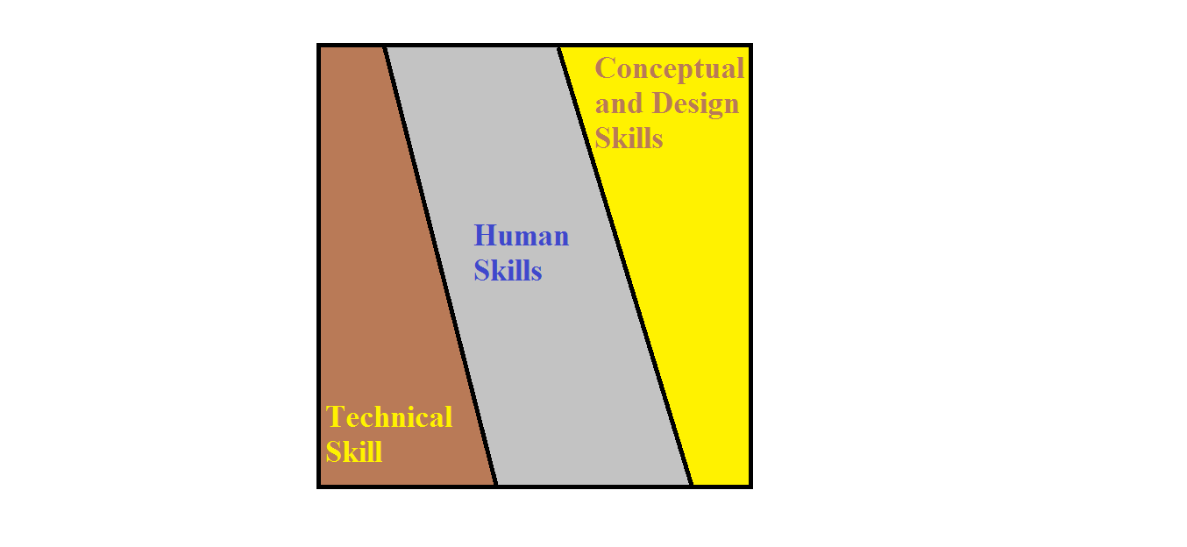
SKILLS AT MANAGERIAL LEVELS

Slide 30
MINTZBERG’S MANAGERIAL ROLES
Interpersonal
Informational
Decisional

Slide 31
Interpersonal Roles
The figurehead engages in ceremonial
activities.
The leader motivates, communicates, and influences subordinates.
The liaison develops relationships outside his/her unit both inside and outside the organization.

Slide 32
INFORMATIONAL ROLES:
The monitor seeks current information from many sources.
The disseminator transmits information to others both inside and outside the organization.
The spokesperson provides official statements to people outside the organization about company policies, actions, or plans.

Slide 33
Decisional Roles
The entrepreneur initiates change.
The resource allocator allocates resources to achieve outcomes.
The negotiator bargains for his/her unit.
The disturbance handler resolves conflicts.

Slide 34
Henry Fayol’s Fourteen Principles Of Management
Division of work
Authority &Responsibility
Discipline
Unity of command
Unity of direction
Subordination of the individual
Remuneration

Slide 35
Principles Continued
8.Centralization
9. Scalar chain
10.Order
11.Equity
12. Stability of tenure of personnel
13. Initiative
14. Esprit de corps

Slide 36
14 Principles of Management by Henri Fayol (1841-1925)
Division of Work. Specialization allows the individual to build up experience, and to continuously improve his skills. Thereby he can be more productive.
Authority & Responsibility The right to issue commands, along with which must go the balanced responsibility for its function.
Discipline. It means the obedience to the authority, observance of the rules of service and norms of performance.
Unity of Command. Each worker should have only one boss with no other conflicting lines of command.

Slide 37
THE RARE RESPONSIBLE PERSON Example- responsibility
Self motivating
Self aware
Self disciplined
Self improving
Acts like a leader
Doesn’t wait to be told what to do
Picks up the trash lying on the floor
source:HBR

Slide 38
continued
5. Unity of Direction: People engaged in the same kind of activities must have the same objectives in a single plan.
This is essential to ensure unity and coordination in the enterprise. Unity of command does not exist without unity of direction but does not necessarily flows from it.
6. Subordination of individual interest (to the general interest).
Management must see that the goals of the firms are always paramount.
7. Remuneration: Fair remuneration increases workers efficiency and morale and foster good relations between them and management. Payment is an important motivator.
8. Centralization (or Decentralization): This is a matter of degree depending on the condition of the business and the quality of its personnel.

Slide 39
Principles continued
9. Scalar chain (Line of Authority).
A hierarchy is necessary for unity of direction.
Scalar chain refers to the number of levels in the hierarchy from the ultimate authority to the lowest level in the organization. It should not be over-stretched and consist of too-many levels.
But lateral communication is also fundamental, as long as superiors know that such communication is taking place.
10.Order.
Both material order and social order are necessary.
The former minimizes lost time and useless handling of materials. The latter is achieved through organization and selection.
11. Equity. In running a business a ‘combination of kindliness and justice’ is needed.
Treating employees well is important to achieve equity.

Slide 40
continued
12. Stability of Tenure of Personnel
Employees work better if job security and career progress are assured to them.
An insecure tenure and a high rate of employee turnover will affect the organization adversely.
13. Initiative.
Allowing all personnel to show their initiative in some way is a source of strength for the organization.
Even though it may well involve a sacrifice of ‘personal vanity’ on the part of many managers.
14. Esprit de Corps.
Management must foster the morale of its employees.
real talent is needed to coordinate effort, encourage keenness, use each person’s abilities, and reward each one’s merit and creating harmonious relations.

Slide 41
Five Functions Of Managers
Stated as
1. Planning
2. Organizing
3. Staffing
4. Leading
5. Controlling

